Slide 1

FireEye
Group 2:Kaustuv DUTTA, Zaki KHAN, Swati M.RADIA, Jada N. Simpson, Jeremiah WARREN

Slide 2





What is FireEye?
FireEye prides itself on being an intelligence-led security company.
FireEye provides Products & Security Consulting in the following areas:
Enterprise Security
FireEye Expertise
Vertical Markets
Security Services
Notes:
FireEye was established in 2004. FireEye was a publicly traded cybersecurity company headquartered in California with offices across North America, Europe , Asia Pacific, Middle East and Africa. The company specialized in providing software, hardware and support services in the cybersecurity field. It assisted organizations in implementing network security solutions, protecting their networks against malicious software and investigating cybersecurity attacks.
FireEye, now known as Trellix (Created from merger of McAfee Enterprise & FireEye) prides itself on being an intelligence-led security company.
FireEye offers a SINGLE platform in which they strive to eliminate complexity & burden of cyber security for organizations struggling to prepare for, prevent & respond to cyber attacks.
FireEye quick facts:
Employees – 3,000+
Revenue - $941 million for 2020
Global Offices – 19
Customers – 10,000+ across 103 countries; More than 50% of the Forbes Global 2000
FireEye Products & Security Consulting
Enterprise Security
FireEye Helix Security Operations Platform
Mandiant Security Validation
FireEye Network Security & Forensics
FireEye Email Security
FireEye Endpoint Security
FireEye Detection on Demand
FireEye Expertise
Mandiant Expertise on Demand
Mandiant Managed Defense
Mandiant Threat Intelligence
Vertical Markets
Cloud
Financial Markets
Government
Healthcare
Industrial Control Systems
Security Services
Breach Response services
Security Assessment services
Security Enhancement services
Security Transformation services
// Zak, Kaustuv

Slide 3
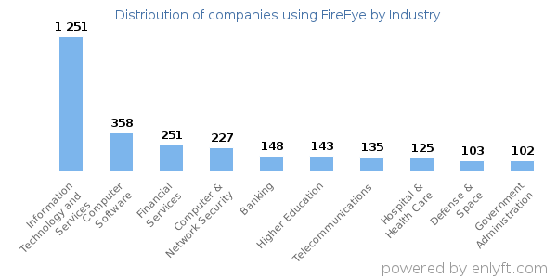

Snapshot of FireEye in 2020
Client List
Most of FireEye’s client are US-based
Top 3 Industries using FireEye: Information Technology and Services, Computer Software, and Financial Services
Investing in AI:
MalwareGuard, part of FireEye’s Endpoint Security suite, won first prize in the U.S. Navy’s Artificial Intelligence Applications for Autonomous Cyber Security Challenge
FireEye purchased Respond Software, a cybersecurity investigations company centered around AI products
Received $400 million strategic investment to support strategic growth initiatives
Notes:
Setting the scene for FireEye in 2020
Background Information:
Around 69% of the FireEye clients were based in the US, and a large percentage of the clients belonged to the computer software and IT services industry. Of all the companies that used FireEye products and services, 19% were small enterprises, 40% were medium sized and 41% were large companies.
In March 2020, FireEye won a very high-profile competition sponsored by the US Navy called the Artificial Intelligence Applications to Autonomous Cybersecurity Challenge. (AI ATAC)
The total staff strength of the company globally was approximately 3200 employees. Comprising more than 700 highly experienced threat researchers, platform engineers, Malware analysts, Intelligence analysts and Investigators. FireEye had deployed more than 17 million VM sensors globally and blocked between 50,00 to 70,000 confirmed malicious events per hour.
https://www.businesswire.com/news/home/20210202006110/en/FireEye-Reports-Financial-Results-for-Fourth-Quarter-and-Full-Year-2020
https://www.mandiant.com/resources/blog/malwareguard-fireeye-machine-learning-model-to-detect-and-prevent-malware
https://enlyft.com/tech/products/fireeye

Slide 4
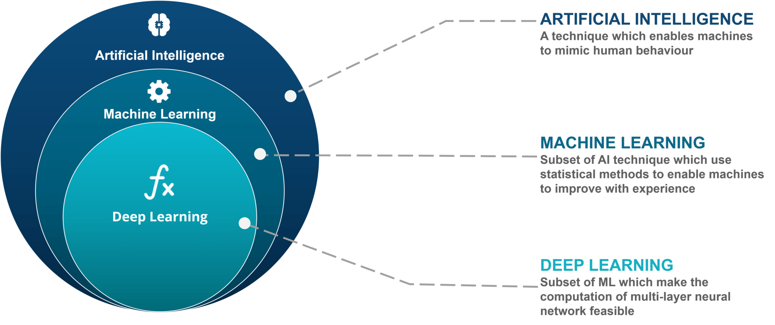
AI/ML: Introduction
Machine refers to computer (software and algorithms)
These machines learn by using data to acquire, update, or refine their outputs
Machine learning uses models or algorithms to find patterns in data that are not otherwise easily identified
FireEye used the Cosine Similarity algorithm to determine whether threat clusters were part of an existing entity or a new entity
Notes:
Quick intro to AI/ML
The case revolves around Human+AI/ML
This allows companies like FireEye to automate certain tasks and for the system to "learn" behaviors through a series of models/algorithms.

Slide 5
AI/ML for Cybersecurity
AI/ML Limitations
AI/ML Capabilities
Unable to make decisions in case of anomalies
False positives
Prioritize incident response.
Unable to adapt to threat landscape
Humans are needed to monitor alerts provided by AI and determine genuine attacks.
Ability to patch known or detected errors and vulnerabilities.
Ability to understand implicit and explicit concepts
Faster Implementation
Able to determine potential problems, but unable to
Ability to monitor 24/7
Analyze data for patterns, notice irregularities
Lack of human error (Assuming Correct Models)
Frees up time for human analysts
Notes:
This list shows Pros and cons of AI/ML
AI/ML helps analysts automate tedious tasks
And allows Analysts to focus on high priority tasks that require expert human making decisions.
There will be a continued need for human capability that works together with AI/ML.
Important to note that the team demonstrated efficient ways to integrate AI/ML. They utilized Agile approaches and ensures everyone was involved from start to finish to ensure no finger-pointing and that buy-in was received by everyone.
There was an understanding that their AI & ML model was continuously evolving in iterations and constructive feedback was encouraged.
Roles may evolve but we believe the human element will always continue to be present

Slide 6


How does FireEye make use of AI?

Slide 7
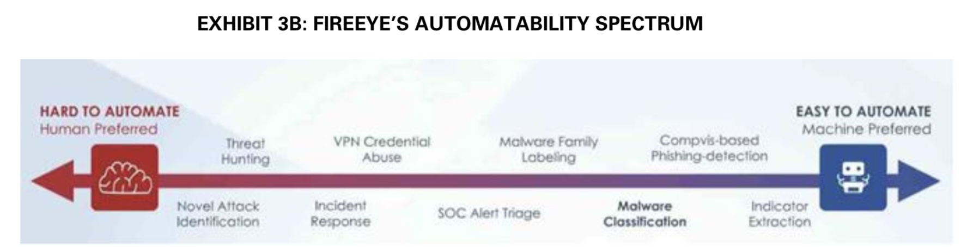
FireEye's Use of AI
Notes:
This is the Automation Specturm FireEye uses to help guide internal thinking on identifying scenarios on if a human or machine approach should be used and at what degree.

Slide 8

Human + AI Approach Risk Analysis
Assets
Atomicity
Centralized data
SME’s
Infrastructure and data management
Remote systems sending in telemetry data
Red team tools – help to penetrate the system
Blue team tools – help to prevent attacks
Reputation
Vulnerabilities
Continuous need to train the model
Need for labelled data
Solutions are built iteratively
Threats
Data Integrity - Infiltrating the data used to train ML model
Availability of data( to train the model of a new attack variant)
Novel Threats
Human element
Controls
Agile approach (tools were designed quickly)
Test-learn-improve (Continuous training ML model)
Team's collaboration. (issues get highlighted and fixed quickly)

Slide 9
Qualitative Risk Analysis
Risk Assessment | Probability of Attack | Business Impact | Cost to fix | Difficulty to fix | Risk Level | Decision
Data Integrity | Medium | High | Medium | High | Medium | Risk Mitigation
Data Availability | Medium | High | Low | Low | Low | Risk Mitigation
Novel Threats | Low | High | Medium | Medium | High | Risk Mitigation/Risk Acceptance
Human | Low | High | Low | Low | Medium | Risk Acceptance

Slide 10
Quantitative Risk Analysis
Threats | Probability | Impact | P.I Score | Risk Ranking | Decision
Data Integrity | 3 | 5 | 15 | 2 | Risk Mitigation
Data Availability | 3 | 5 | 15 | 3 | Risk Mitigation
Novel Threats | 2 | 5 | 10 | 1 | Risk Mitigation/Risk Acceptance
Human | 2 | 5 | 10 | 4 | Risk Acceptance

Slide 11

The Breach of 2020
Hack was suspected to be caused by a Nation-State (Russia)
Attack carried out through a backdoor trojan
Hackers stole RedTeam tools
Used to simulate attacks on corporations, so that defenses can be built.
Using tools and techniques that a hacker would use
Did not contain zero-day exploits
Ramifications:
Persistent advanced threats
Hackers can enhance their capabilities and see how companies are building their defenses
Notes:
Even a top cybersecurity company like FireEye was susceptible to an attack.
A ‘red team’ is usually externally hired by an organisation and has little or no inside knowledge of the cybersecurity in place. This ensures the attack that it performs will be completely realistic with the ‘red team’ performing the techniques that would be used in a real attack.
The attack used tools specifically designed to countermand FireEye's security protocols. The attack began with the injection of the SUNBURST backdoor trojan. This was transmitted through updates to the SolarWinds Orion software platform, where the updates had been hijacked and altered to include the malware (in something known as a supply-chain breach). Utilising this backdoor, the bad actors were able to access FireEye's internal servers and extract data and ‘red team’ tools used by FireEye.

Slide 12

What is your opinion on the future use of AI/ML for cybersecurity?

Slide 13
Current Trends
FireEye
FireEye, acquired by STG and now known as Trellix, continues to invest in AI and ML learning (including deep learning neural networks)
New AI/ML-based products like Trellix Insights: “highly proactive threat intelligence solution predicts and prioritizes threats and prescribes countermeasures, so you can get ahead of adversaries.”
Continue to develop and refine Security Analytics tools for automated threat detection
Cybersecurity Industry Trends
Cybersecurity companies invest in AI/ML solutions to protect their clients
Investments in AI/ML free up time for SMEs to work on complex tasks
AI in the cybersecurity market is projected to reach USD 38.2 billion by 2026 up from USD 8.8 billion in 2019
Consolidating multiple security products through XDR (extended detection response) platforms with AI/ML incorporated into the platform
AI/ML
Increase in AI/ML adoption, spreading into all sectors
91% of leading businesses have ongoing investments in artificial intelligence
AI in decision-making. How much will organizations rely on AI/ML for decision-making?
Notes:
Continuous investments being made in AI/ML
This free's up time for SME's to focus on high priority items.
From a market standpoint, AI in Cybersecuirty is projected to reach 38 billion by 2026, it was 8.8 billion in 2019

Slide 14

Do you believe that companies should take a Human + AI approach or just an AI? Why or why not?

Slide 15

Our Thoughts
The cyber threat environment is constantly changing
Hackers are now using AI tools to target and attack their victims
New Technologies (a/k/a New Attack Vectors for Hackers):
IoT
Blockchain
5G
Cloud Computing
FireEye and other cybersecurity companies must continue to enhance their capabilities and must continuously innovate to protect their clients
Notes:
Even after the increase in use of AI in Cybersecurity, Cyberthreat is a growing phenomenon.
> With the rapid growth of new technologies, especially IOT, it provides attackers with more loopholes and attack surfaces.
> New technologies like Blockchain, Behavioral Analytics and Embedded Hardware Authentication technologies is changing the threat landscape. More sophisticated attackers are producing new mechanisms.
> FireEye and other cybersecurity companies actively use ML to continue to enhance their capabilities for developing, deploying and supporting deep learning models for threat analysis.

Slide 16
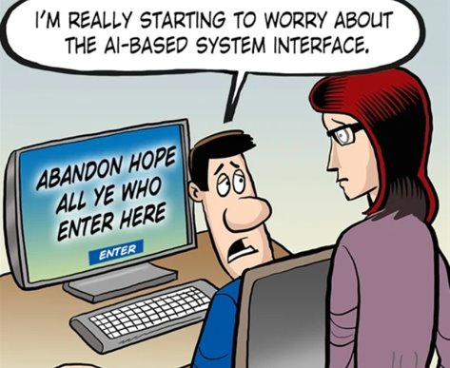
Do you think AI is inherently good or evil?

Slide 17
Thank You

